Slide 1
Credit EDA Assignment
Case Study
Sai Vaibhav Naidu
Email: svnhpt.vaibhav@gmail.com
Phone: +917829999128

Slide 2
Problem Statement
The loan providing companies find it hard to give loans to the people due to their insufficient or non-existent credit history. Because of that, some consumers use it to their advantage by becoming a defaulter. Suppose you work for a consumer finance company which specialises in lending various types of loans to urban customers. You have to use EDA to analyse the patterns present in the data. This will ensure that the applicants capable of repaying the loan are not rejected.
When the company receives a loan application, the company has to decide for loan approval based on the applicant’s profile. Two types of risks are associated with the bank’s decision:
If the applicant is likely to repay the loan, then not approving the loan results in a loss of business to the company
If the applicant is not likely to repay the loan, i.e. he/she is likely to default, then approving the loan may lead to a financial loss for the company.

Slide 3
Business Objective
This case study aims to identify patterns which indicate if a client has difficulty paying their instalments which may be used for taking actions such as denying the loan, reducing the amount of loan, lending (to risky applicants) at a higher interest rate, etc. This will ensure that the consumers capable of repaying the loan are not rejected. Identification of such applicants using EDA is the aim of this case study.
In other words, the company wants to understand the driving factors (or driver variables) behind loan default, i.e. the variables which are strong indicators of default. The company can utilise this knowledge for its portfolio and risk assessment.

Slide 4
Steps for Analysis
Data Sourcing
We need to read the 2 csv files given to us.
application_data.csv will be stored in dataset inp0
previous_application.csv will be stored in dataset inp1
Joining the 2 datasets into a single dataset after the analysis to compare the data
Data Cleaning
Drop the columns or rows with more than 30% NULL values present it.
Impute or replace the missing data in the dataset based on the amount of missing values.
Removing unwanted columns which is unnecessary for the analysis
Performing Univariate analysis
Dividing the dataset into 2. Target_0 and Target_1 which represent no payment issues and payment issues respectively
Performing the analysis on AMT_ANNUITY, AMT_CREDIT, AMT_INCOME_TOTAL by box plot, bar graphs, and creating the buckets
Calculating the correlation between the two sets to plotting the heatmaps
Checking for the outliners in the data and making the final judgement

Slide 5
Notes
I did the coding in Google collabs and have commented on the lines as and when it is required throughout the code cells
The coding file is attached along with this presentation in .ipynb file
I have presented the important graphs here in he slides and will be taking through the final conclusion based on it.
To get the proper understanding, please go through the coding file as the majority of the steps will not be included here in the slides

Slide 6

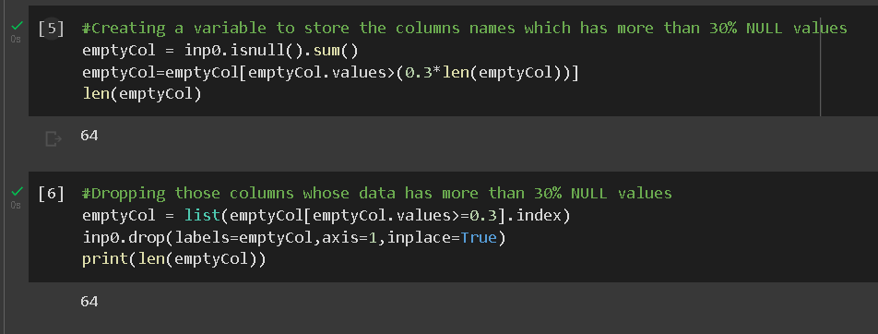
Data Cleaning in brief
We can observe that there are 307511 rows and 122 columns
We found that there are 64 columns with more than 30% NULL values
Those columns are dropped
Similarly columns and rows with null values or XNA values are found and either removed or replaced with the most common value or the median value(in case of numeric column)

Slide 7
Categorical Univariate Analysis

Slide 8
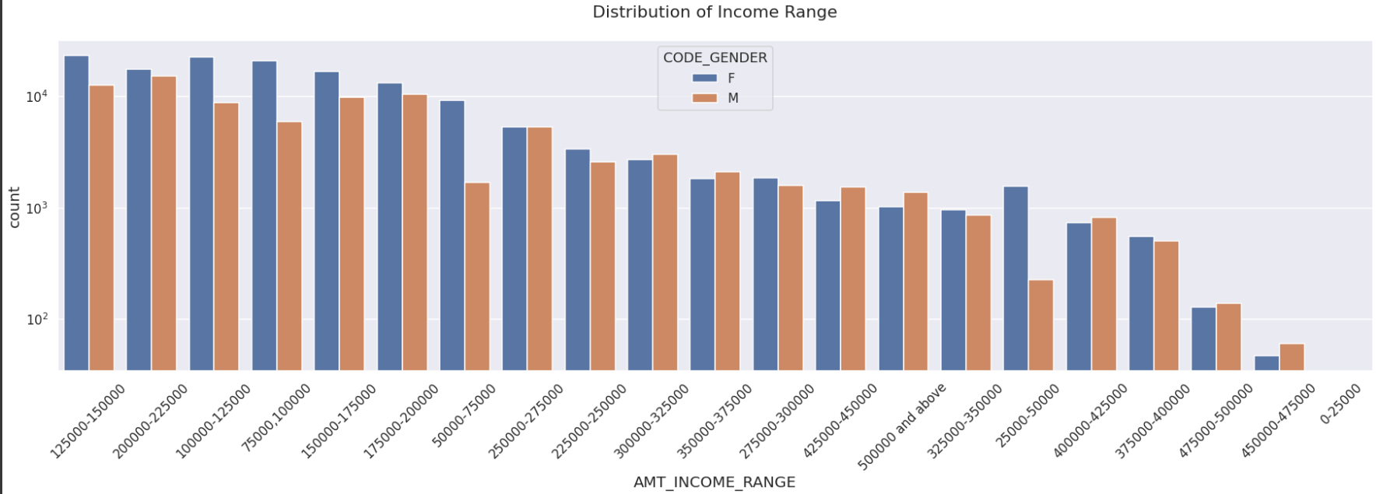
Analysis for Target - 0: Clients with no payment difficulty
Bar plot for different income ranges
Female counts are higher than male.
Income range from 100000 to 200000 is having more number of credits.
Very less count for income range 400000 and above

Slide 9
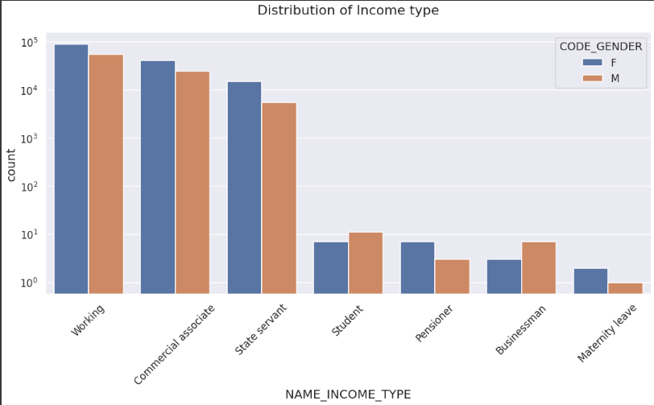
Analysis for Target - 0: Clients with no payment difficulty
Bar plot for different income types
For income type ‘working’, 'commercial associate’, and ‘State Servant’ the number of credits are higher than others.
For this Females are having more number of credits than male.
Less number of credits for income type ‘student’ ,’pensioner’, ‘Businessman’ and ‘Maternity leave’.

Slide 10
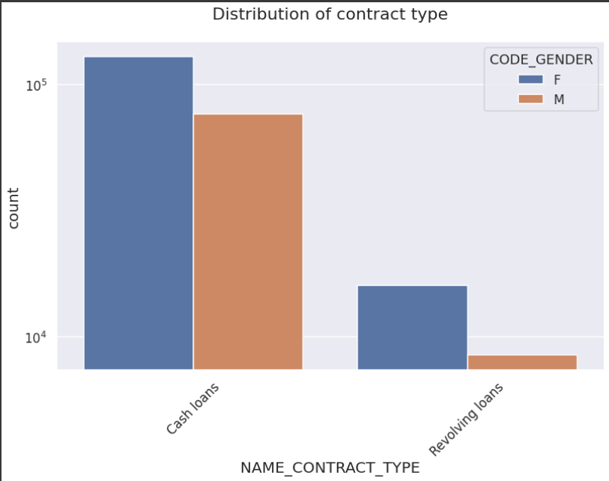
Analysis for Target - 0: Clients with no payment difficulty
Bar plot for different contract types
For contract type ‘cash loans’ is having higher number of credits than ‘Revolving loans’ contract type.
In this category too, Females are leading for applying credits.

Slide 11
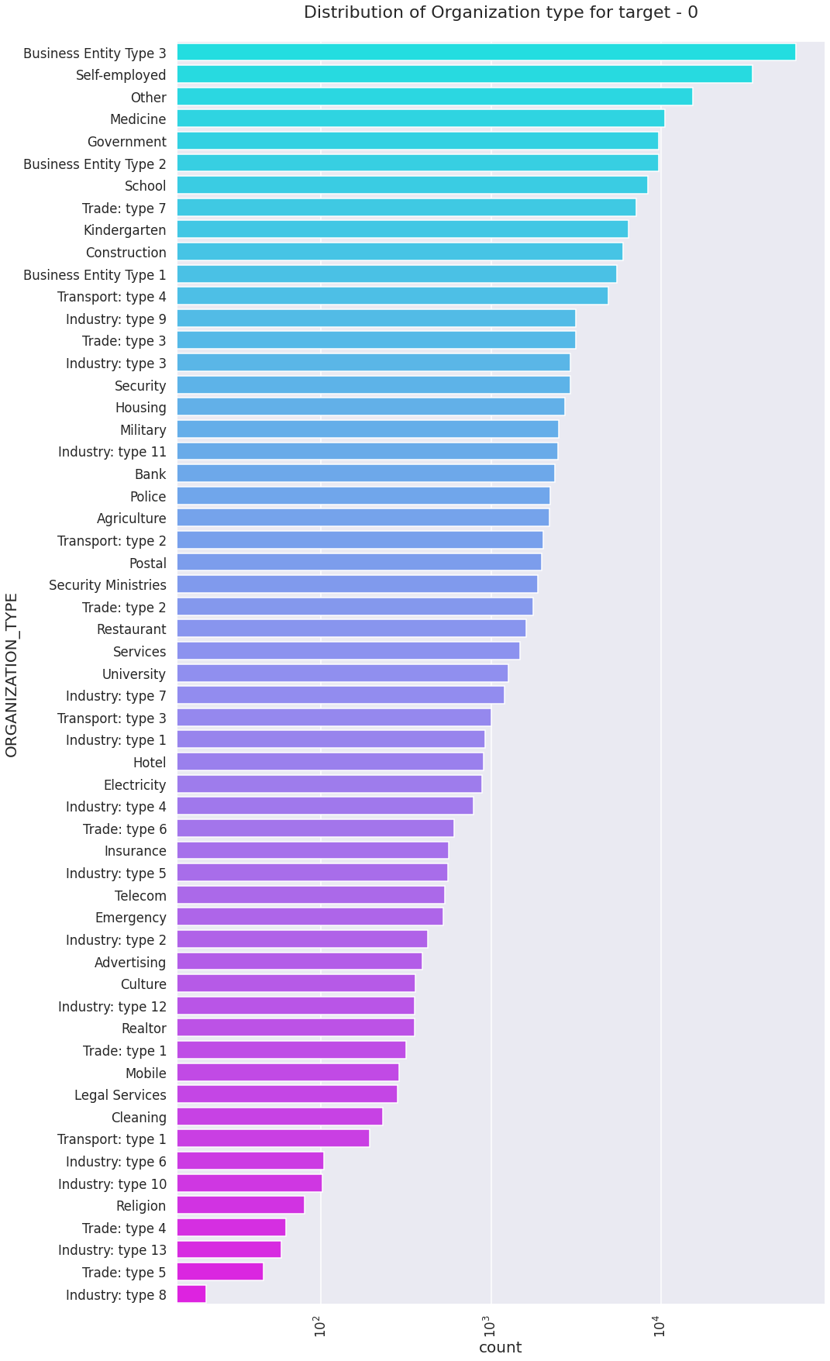
Analysis for Target - 0: Clients with no payment difficulty
Horizontal Bar plot for different Organization types
Clients which have applied for credits are from most of the organization type ‘Business entity Type 3’ , ‘Self employed’, ‘Other’ , ‘Medicine’ and ‘Government’.
Less clients are from Industry type 8,type 6, type 10, religion and trade type 5, type 4

Slide 12
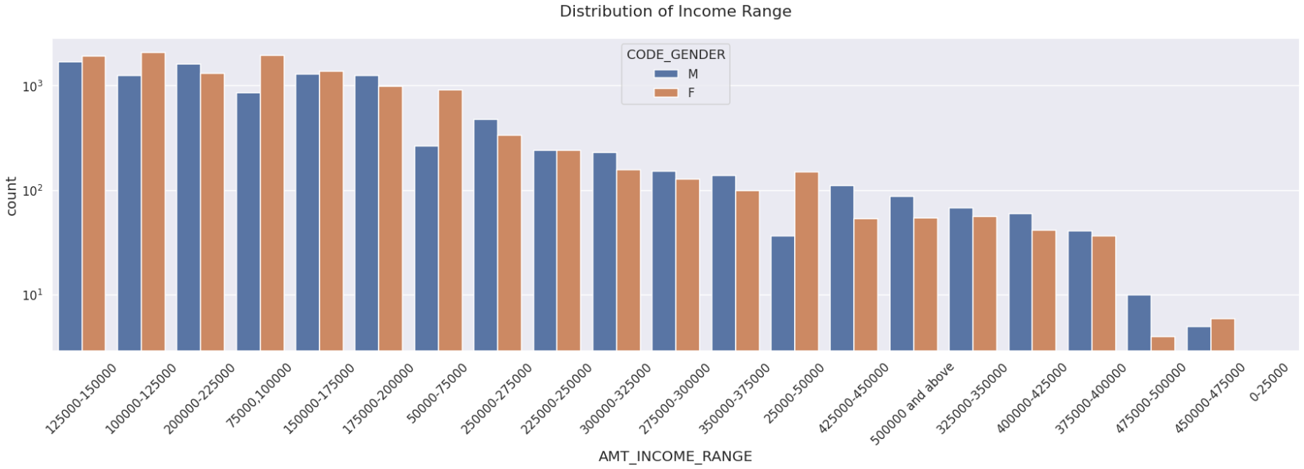
Analysis for Target - 1: Clients with payment difficulty
Bar plot for different income ranges
Male counts are higher than female.
Income range from 100000 to 200000 is having more number of credits.
This graph show that males are more than female in having credits for that range.
Very less count for income range 400000 and above.

Slide 13
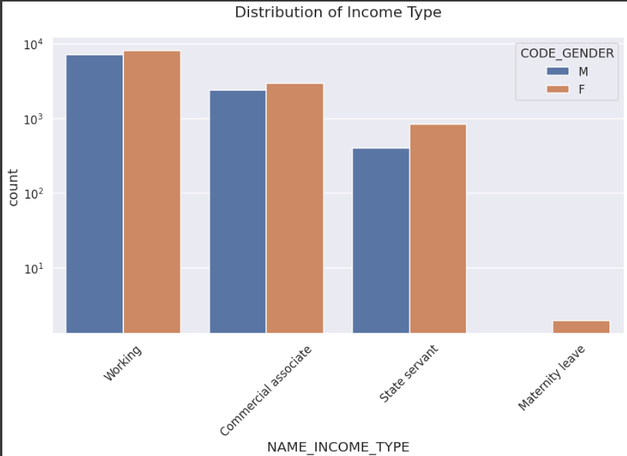
Analysis for Target - 1: Clients with payment difficulty
Bar plot for different income types
For income type ‘working’, ’commercial associate’, and ‘State Servant’ the number of credits are higher than other i.e. ‘Maternity leave.
For this Females are having more number of credits than male.
Less number of credits for income type ‘Maternity leave’.
For type 1: There is no income type for ‘student’ , ’pensioner’ and ‘Businessman’ which means they don’t do any late payments.

Slide 14
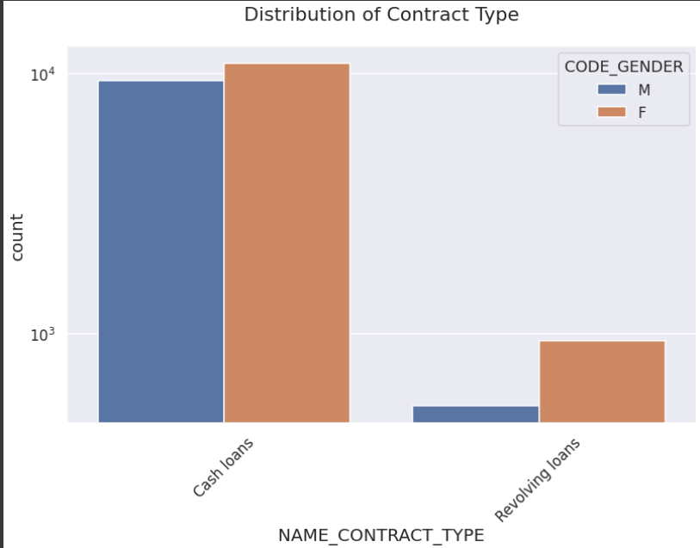
Analysis for Target - 1: Clients with payment difficulty
Bar plot for different contract types
For contract type ‘cash loans’ is having higher number of credits than ‘Revolving loans’ contract type.
For this also Female is leading for applying credits.
For type 1 : there is only Female Revolving loans.

Slide 15
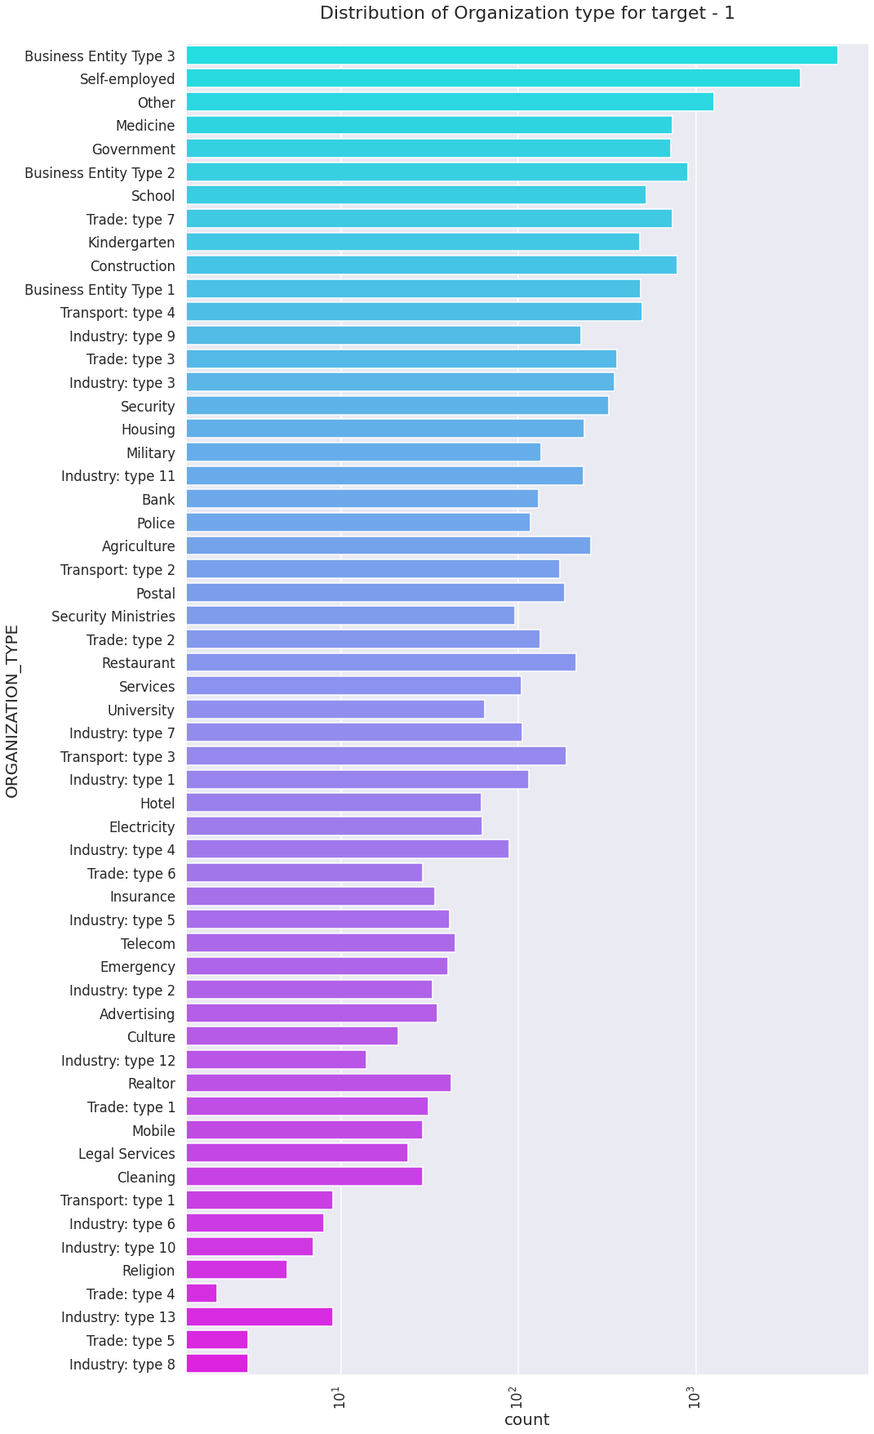
Analysis for Target - 1: Clients with payment difficulty
Horizontal Bar plot for different Organization types
Clients which have applied for credits are from most of the organization type ‘Business entity Type 3’ , ‘Self employed’ , ‘Other’ , ‘Medicine’ and ‘Government’.
Less clients are from Industry type 8,type 6, type 10, religion and trade type 5, type 4.
Same as type 0 in distribution of organization type.

Slide 16
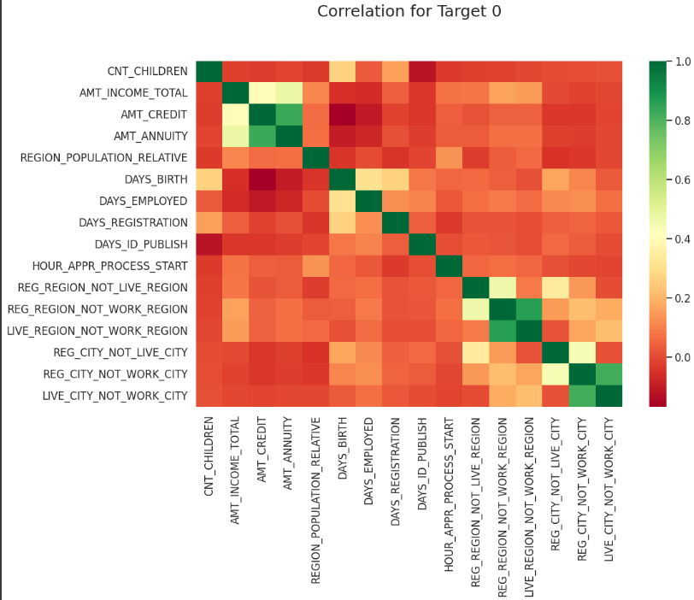
Correlation between Target 0 and 1
Heat maps plotting correlation for target 0
Credit amount is inversely proportional to the date of birth, which means Credit amount is higher for low age and vice-versa.
Credit amount is inversely proportional to the number of children client have, means Credit amount is higher for less children count client have and vice-versa.
Income amount is inversely proportional to the number of children client have, means more income for less children client have and vice-versa.
less children client have in densely populated area.
Credit amount is higher to densely populated area.
The income is also higher in densely populated area.

Slide 17
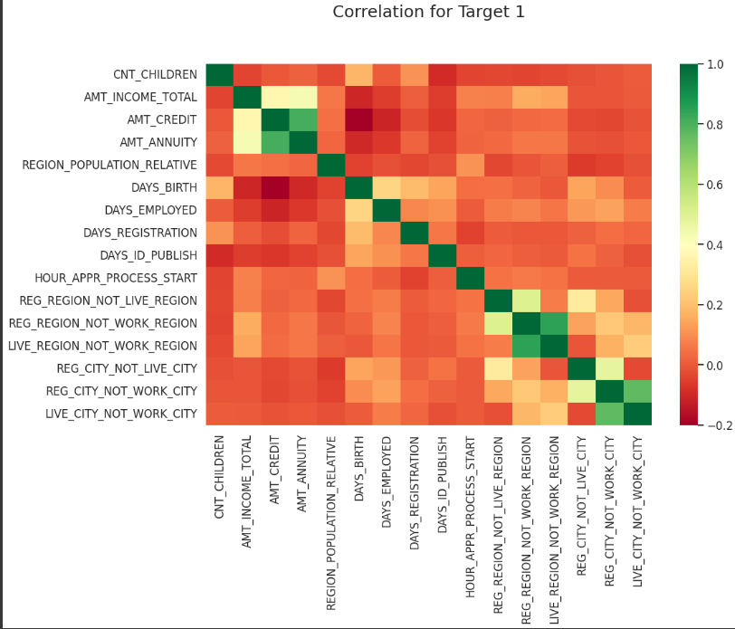
Correlation between Target 0 and 1
Heat maps plotting correlation for target 1
Here the heat map readings is almost same as observed for Target 0
The client's permanent address does not match contact address are having less children and vice-versa
The client's permanent address does not match work address are having less children and vice-versa

Slide 18
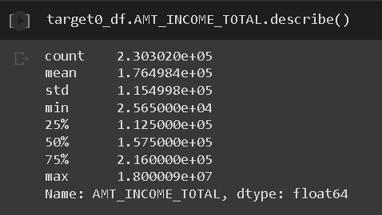
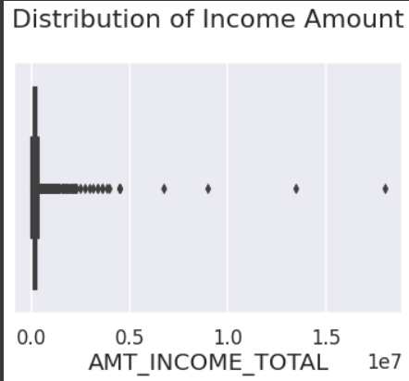
Checking for Outliners - Target 0
For Income Amount
1. Some outliers are noticed in income
amount.
2. The third quartiles is very slim for
income amount.

Slide 19
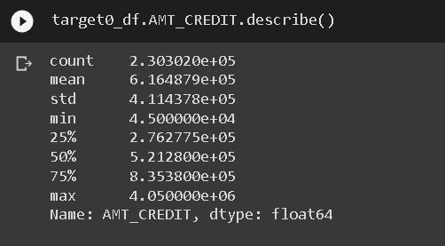
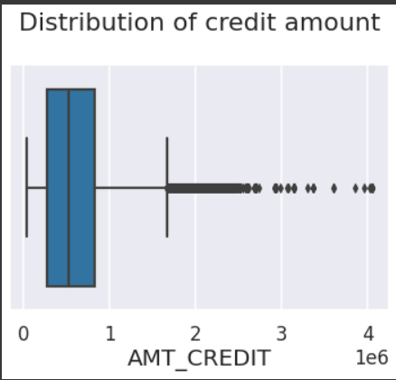
Checking for Outliners - Target 0
For Credit Amount
Some outliners are noticed in credit amount
The first quartile is bigger than third quartile for credit amount which means most of the credits of clients are present in the first quartile.

Slide 20
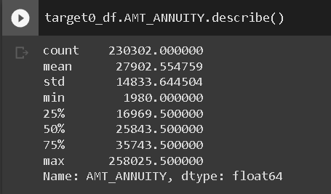
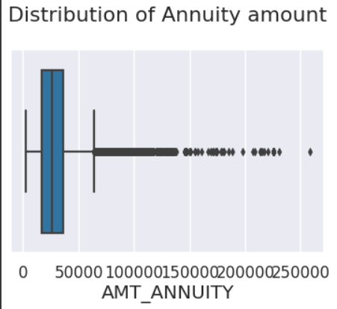
Checking for Outliners - Target 0
For Annuity Amount
Some outliers are noticed in annuity amount.
The first quartile is bigger than third quartile for annuity amount which means most of the annuity clients are from first quartile.

Slide 21
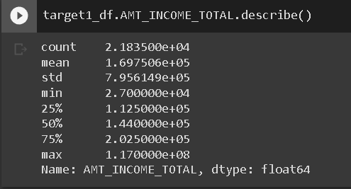
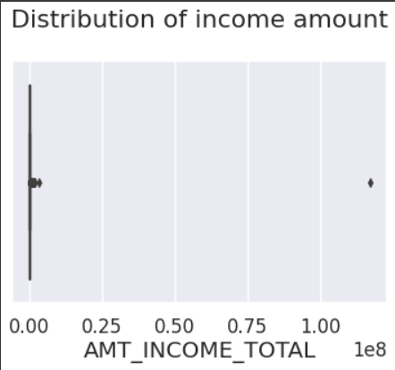
Checking for Outliners - Target 1
For Income Amount
Some outliers are noticed in income amount.
The third quartiles is very slim for income amount.
Most of the clients of income are present in first quartile.

Slide 22
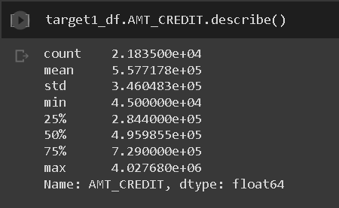
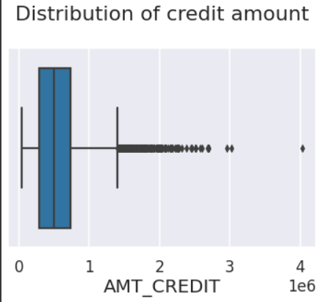
Checking for Outliners - Target 1
For Credit Amount
Some outliers are noticed in credit amount.
The first quartile is bigger than third quartile for credit amount which means most of the credits of clients are present in the first quartile.

Slide 23
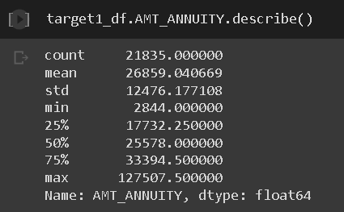
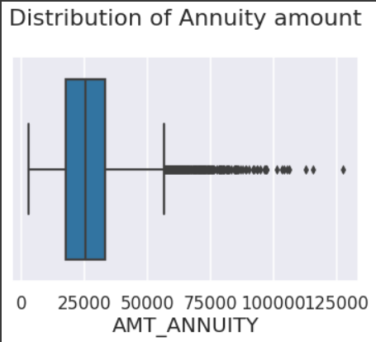
Checking for Outliners - Target 1
For Annuity Amount
Some outliers are noticed in annuity amount.
The first quartile is bigger than third quartile for annuity amount which means most of the annuity clients are from first quartile.

Slide 24
Bivariate Analysis

Slide 25
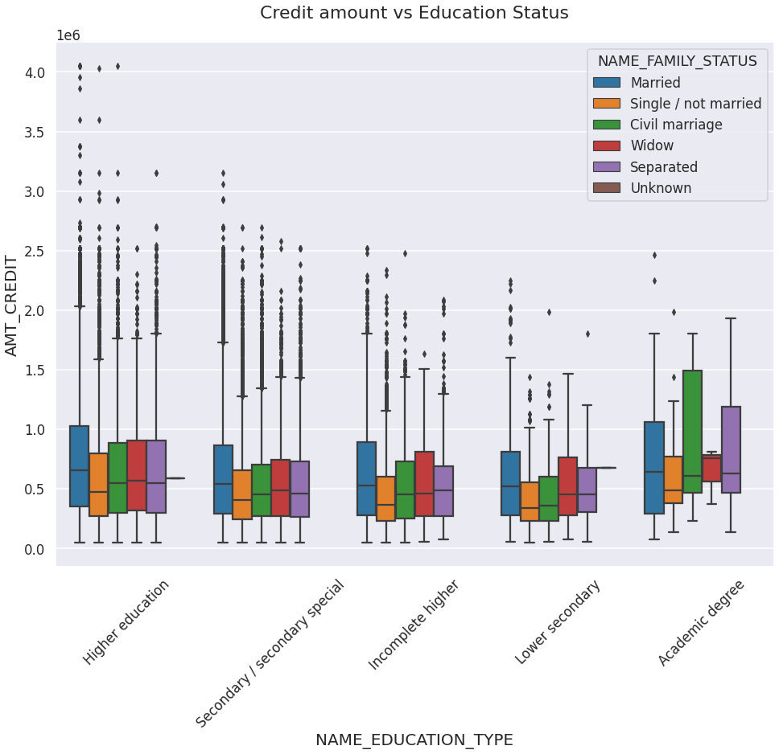
For Target 0
Credit Amount vs Education Status
Family status of 'civil marriage', 'marriage' and 'separated' of Academic degree education are having higher number of credits than others.
Also, higher education of family status of 'marriage', 'single' and 'civil marriage' are having more outliers.
Civil marriage for Academic degree is having most of the credits in the third quartile.

Slide 26
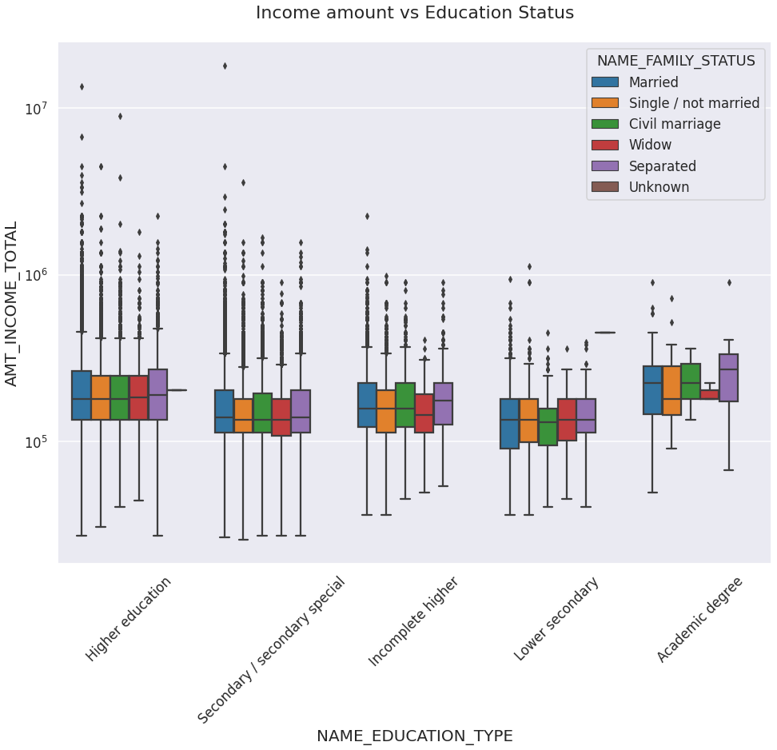
For Target 0
Income Amount vs Education Status
For Education type 'Higher education' the income amount is mostly equal with family status.
It does contain many outliers. Less outlier are having for Academic degree but there income amount is little higher that Higher education.
Lower secondary of civil marriage family status are have less income amount than others.

Slide 27
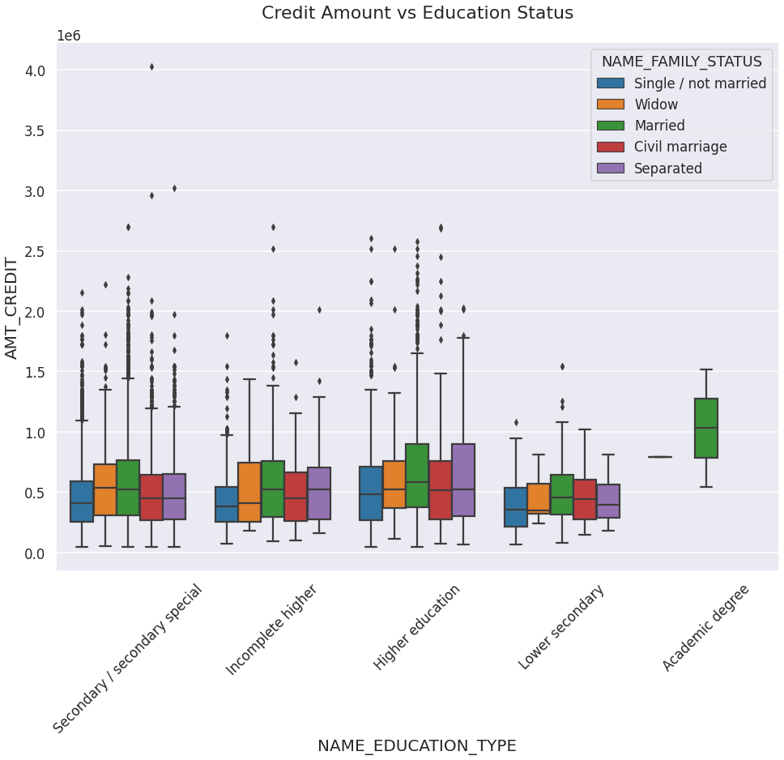
For Target 1
Credit Amount vs Education Status
This is seen quite similar with Target 0
Family status of 'civil marriage', 'marriage' and 'separated' of Academic degree education are having higher number of credits than others.
Most of the outliers are from Education type 'Higher education' and 'Secondary'.
Civil marriage for Academic degree is having most of the credits in the third quartile.

Slide 28
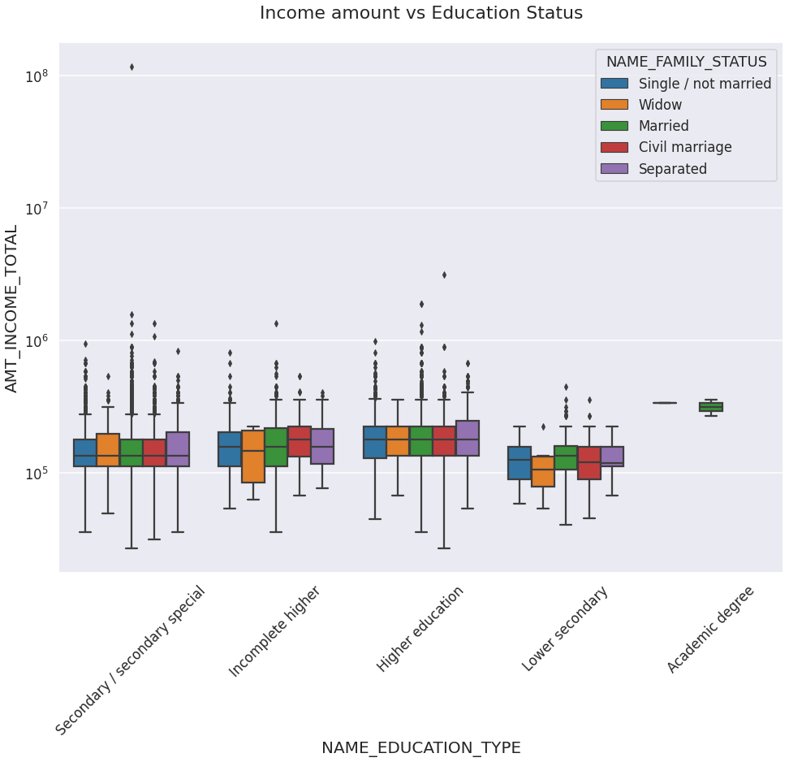
For Target 1
Income Amount vs Education Status
Have some similarity with Target0,
For education type 'Higher education', the income amount is mostly equal with family status.
Less outlier are having for Academic degree but there income amount is little higher that Higher education.
Lower secondary are have less income amount than others.

Slide 29
Univariate Analysis after merging the Previous Application Data

Slide 30
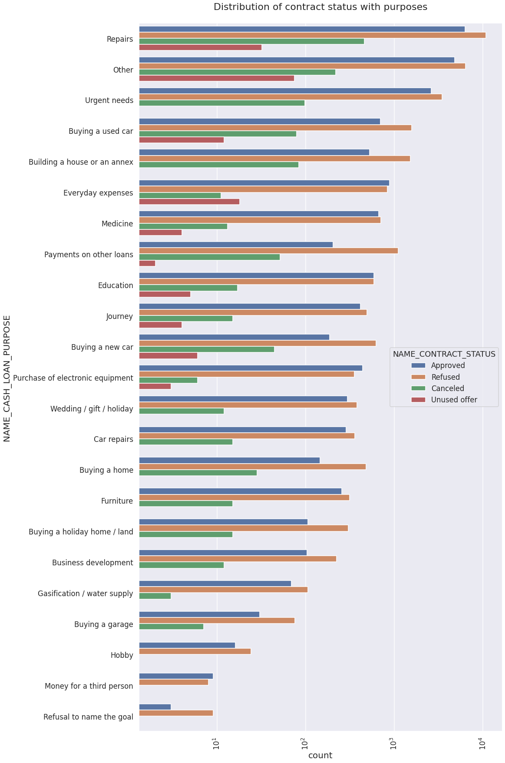
Contract status with Purpose Plot
Most rejection of loans came from purpose 'repairs'.
For education purposes we have equal number of approves and rejection
Paying other loans and buying a new car is having significant higher rejection than approves.

Slide 31
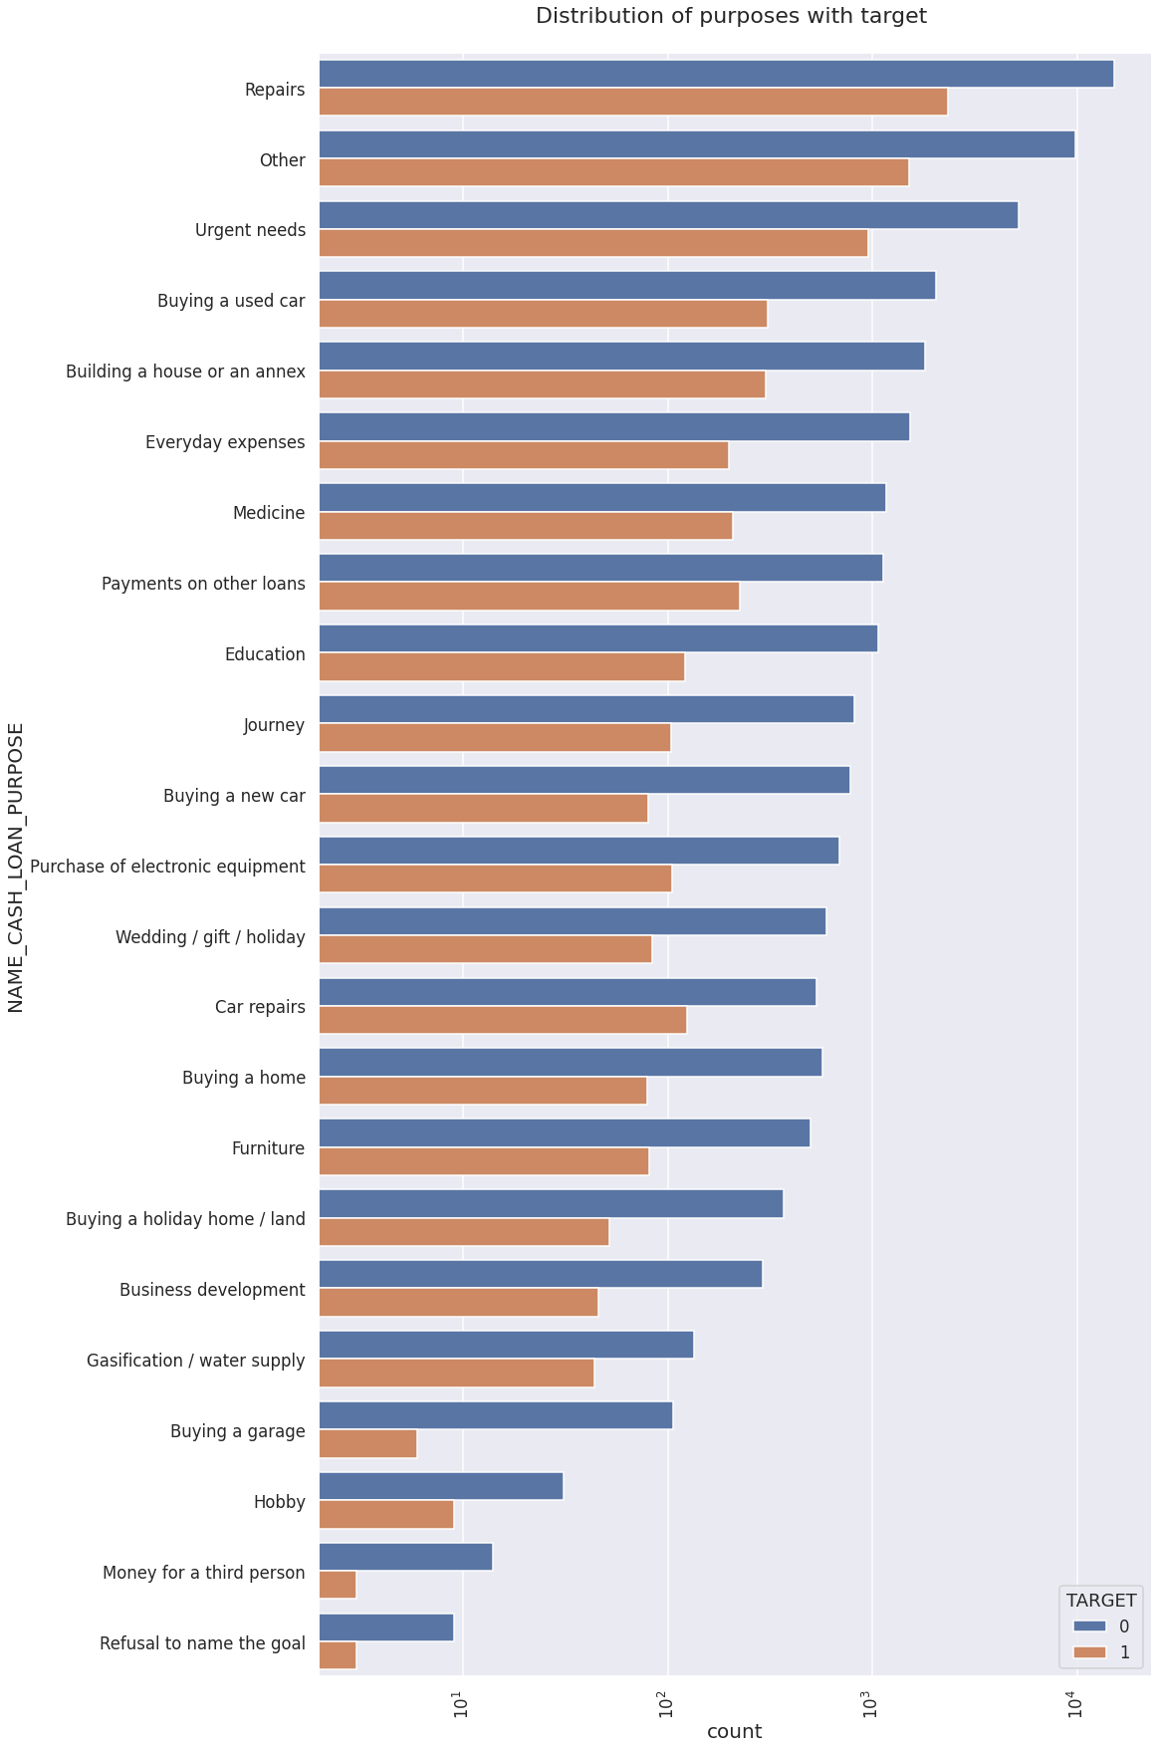
Target With Purpose Plot
Loan purposes with 'Repairs' are facing more difficulties in payment on time.
There are few places where loan payment is significant higher than facing difficulties. They are 'Buying a garage', 'Business development', 'Buying land','Buying a new car' and 'Education'
Hence we can focus on these purposes for which the client is having for minimal payment difficulties.

Slide 32
Bivariate Analysis after merging the Previous Application Data

Slide 33
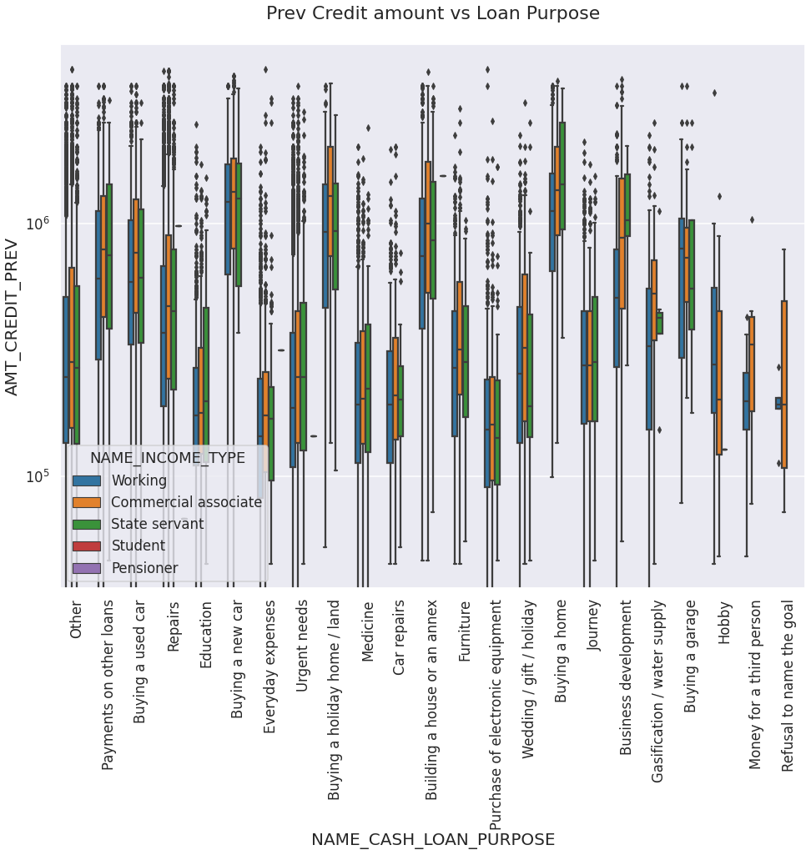
Prev Credit amount vs Loan Purpose
The credit amount of Loan purposes like 'Buying a home','Buying a land','Buying a new car' and 'Building a house' is higher.
Income type of state servants have a significant amount of credit applied
Money for third person or a Hobby is having less credits applied for.

Slide 34
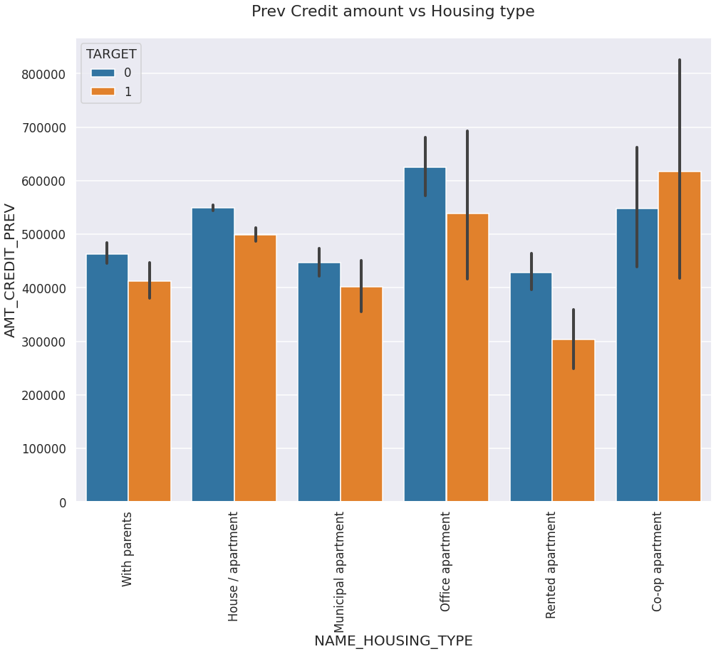
Prev Credit amount vs Housing type
Here for Housing type, office apartment is having higher credit of target 0 and co-op apartment is having higher credit of target 1.
So, we can conclude that bank should avoid giving loans to the housing type of co-op apartment as they are having difficulties in payment. Bank can focus mostly on housing type with parents or House\apartment or municipal apartment for successful payments.

Slide 35
Conclusion
Banks should focus more on contract type ‘Student’ ,’pensioner’ and ‘Businessman’ with housing ‘type other than ‘Co-op apartment’ for successful payments (loan clears).
Banks should focus less on income type ‘Working’ as they are having most number of unsuccessful payments.
Also with loan purpose ‘Repair’ is having higher number of unsuccessful payments on time. Have to try and avoid them as much as possible
Get as much as clients from housing type ‘With parents’ as they are having least number of unsuccessful payments.
Females have majority of credits from the bank and higher rates of successful payments. Although this can’t be a clear indication, this proves that they repay in time.

Slide 36
THANK YOU

